Slide 1



Shifting Landscapes: Rural Economic Trends and Their Impact on People, Policy, and Institutions
Webcast for ICAI
Prof Vidya Vemireddy, IIMA
15th September 2025

Slide 2


Section 1 Sectoral Composition – Contemporary Idea

Slide 3
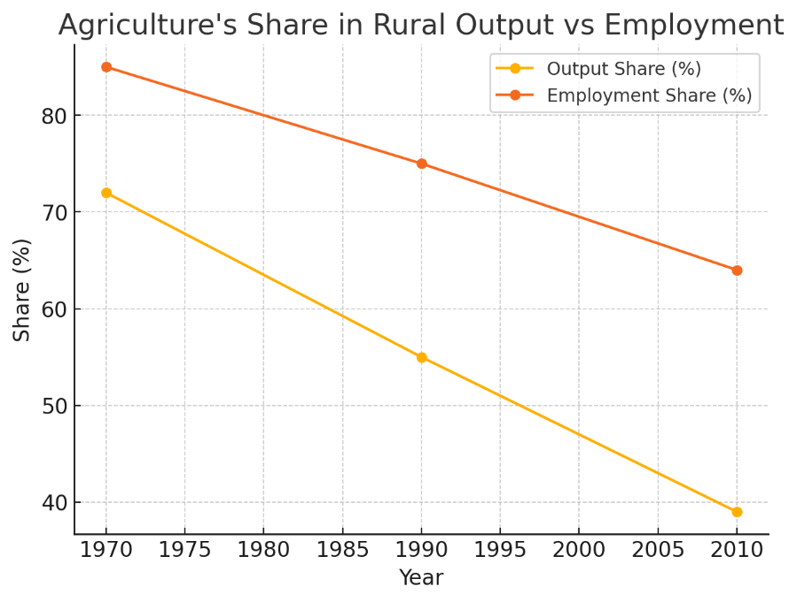
Long-Term Big Shifts in Rural Economy
Rural India has moved beyond being ‘just agriculture,’ yet jobs remain heavily tied to it.
Key points:
Agri share ↓ 72% → 39% of output, still 64% jobs.
Rural = 50% GDP, 350M workers.
Agri chain = $533B revenue, $42B profit.

Slide 4
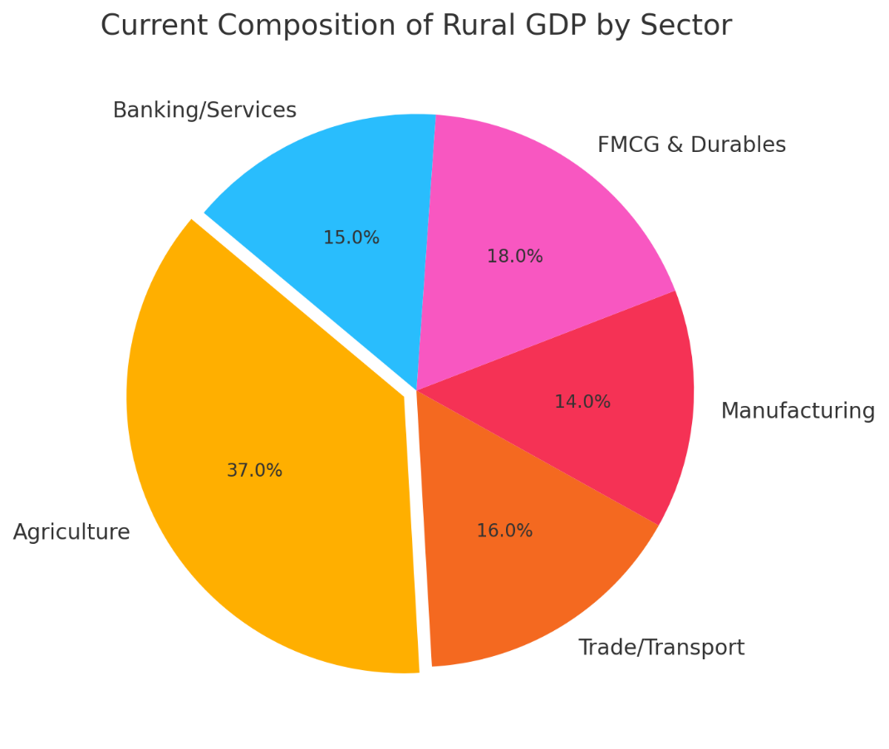
Current Composition of Rural Economy
Rural economy accounts for ~50% of GDP and ~350M workers.
Agriculture remains important, but non-farm sectors, FMCG, and services are expanding.
Compiled from KPMG, Bain, McKinsey, IBEF, and Mordor.

Slide 5
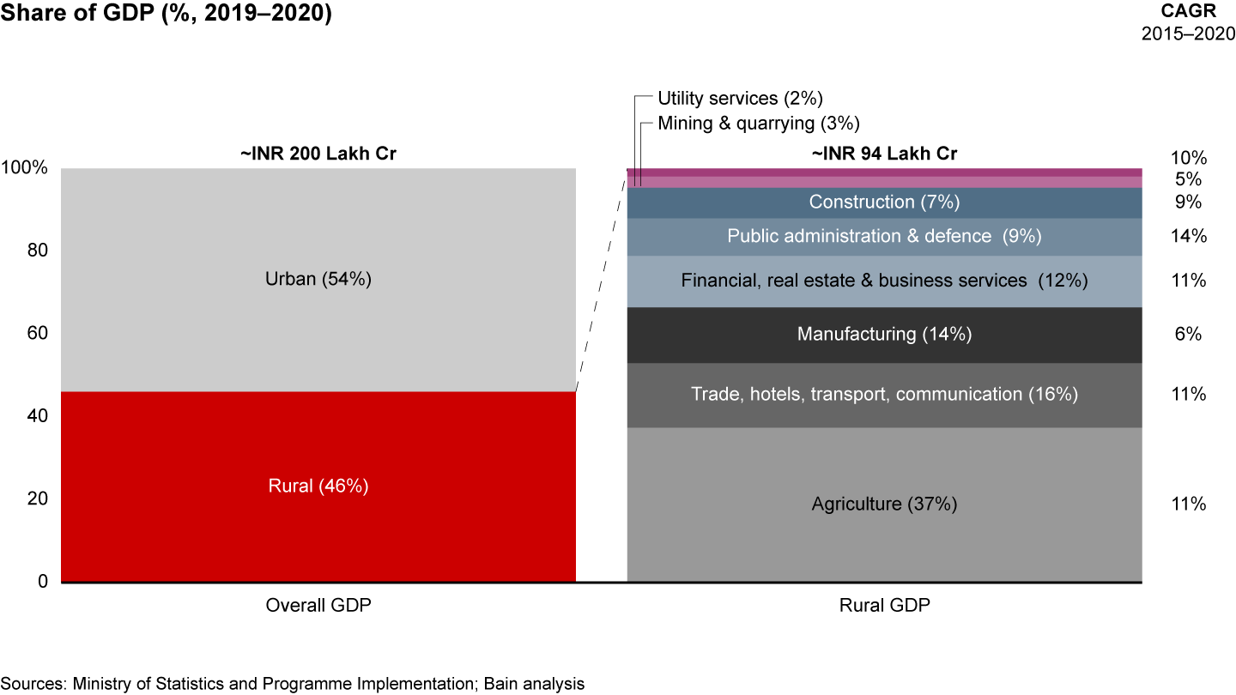

Slide 6
Drivers of Transformation
1. Policy Support
MSP (Minimum Support Price): Provided income security to farmers, incentivised crop diversification.
MGNREGS: Supplemented rural incomes, boosted consumption, and supported infrastructure.
PMJDY (Jan Dhan Yojana): Expanded financial inclusion, enabling savings and credit.
Rural Roads & Connectivity (PMGSY): Linked villages to markets and services.
Agri-Export Policy: Created global market access for farm produce.

Slide 7
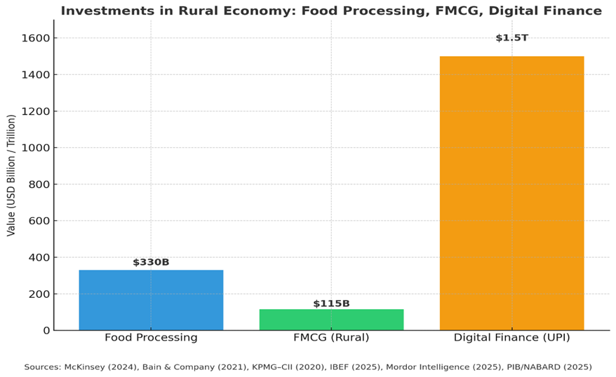
Drivers of Transformation
2. Investments
Food Processing: Improved value-addition [~$100 billion (2023), $220 billion by 2025] and created downstream jobs.
FMCG Penetration: Rural markets grew 3x faster than urban ~$110–115 billion (≈ half of India’s FMCG sector)
Banking & Digital Finance: Credit flows widened (52.6% of rural households rely solely on formal loans); NBFCs and fintech entered rural segments.

Slide 8
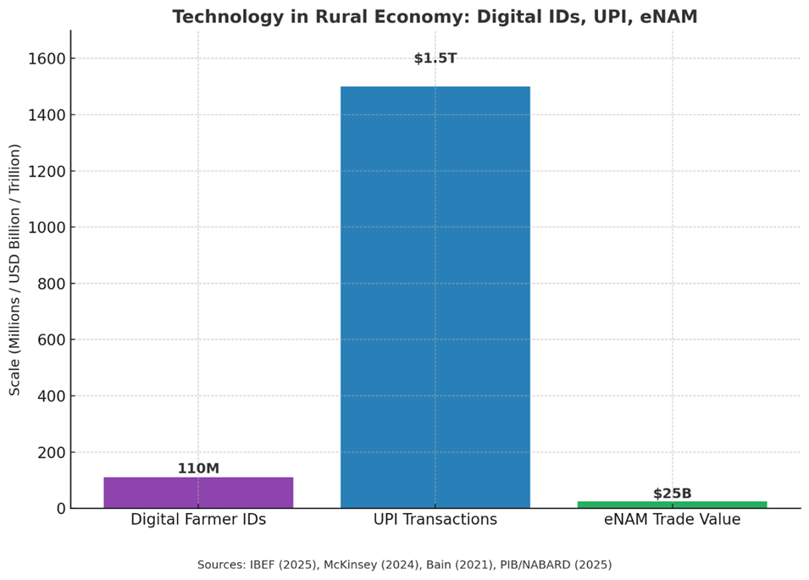
Drivers of Transformation
3. Technology
Digital Farmer IDs: Linked farmers to subsidies, credit, and advisory services.
UPI & Mobile Payments: Enabled direct transfers and expanded financial participation.
eNAM (National Agri Market): Created transparent, digital platforms for trade.

Slide 9
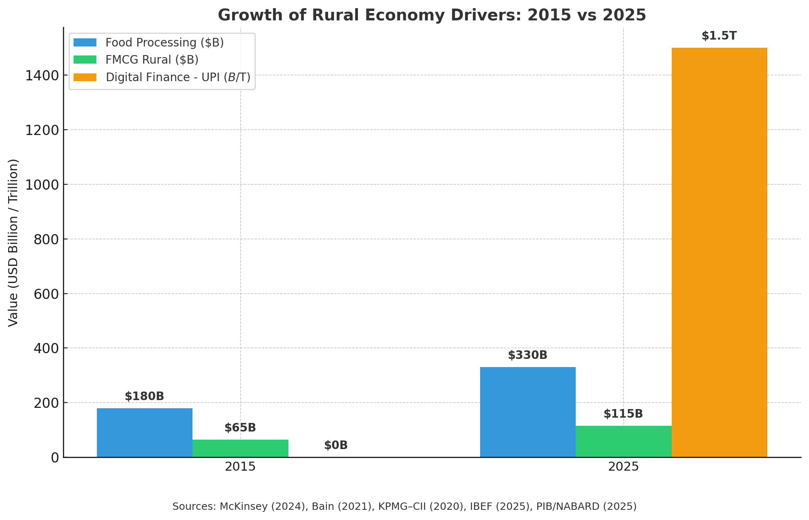
Comparative Growth Analysis

Slide 10
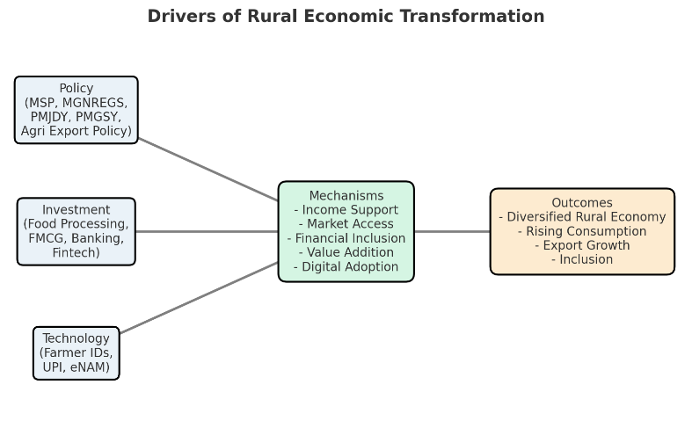
Policies and investments enabling sectoral diversification.

Slide 11

Section 2 Transitional Phase – Growth & Employment, and Structural Challenges

Slide 12
Output–Employment Relationship
Strong output growth ~3–4% CAGR in the last decade, but slower employment growth (“stagnant growth”).
Agri absorbs ~41–45% of India’s workforce, though agriculture’s GDP share is ~16%.
Wage differentials persist: non-farm incomes ≈ 3x higher than agri labour
Trend: Structural mismatch persists — large employment, low output contribution.

Slide 13
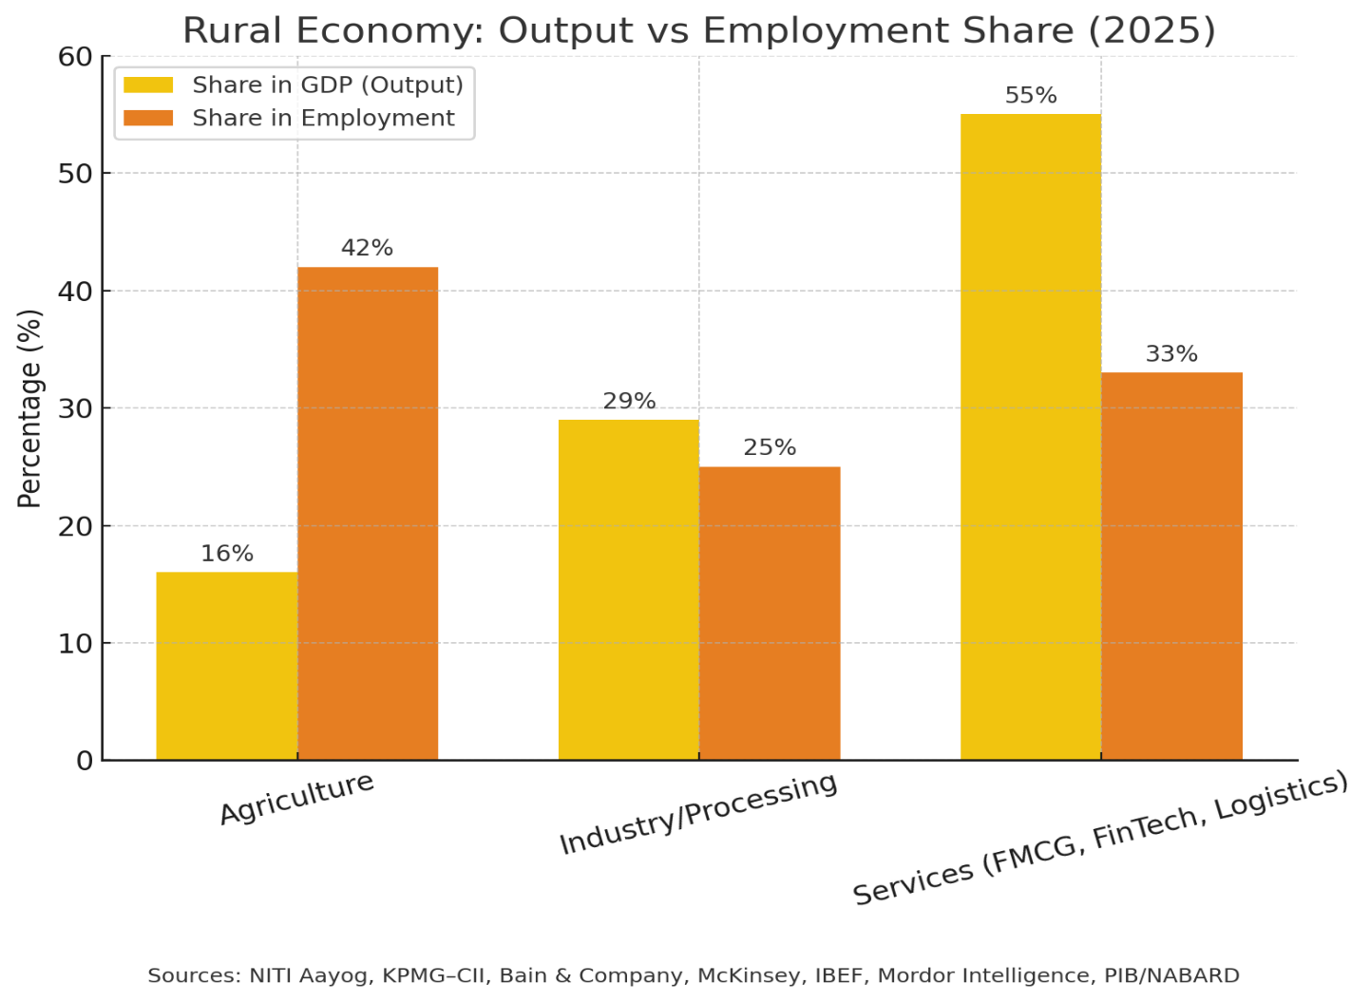
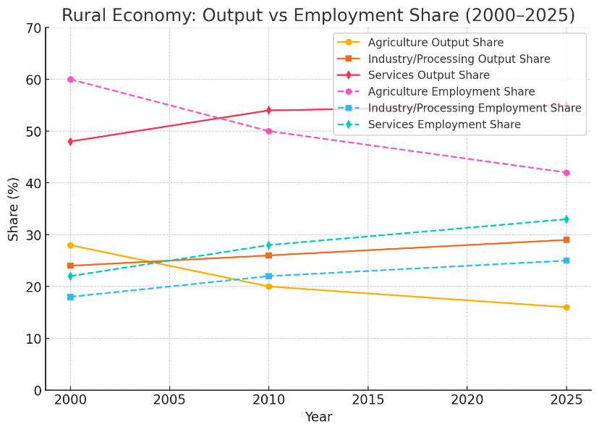

Slide 14
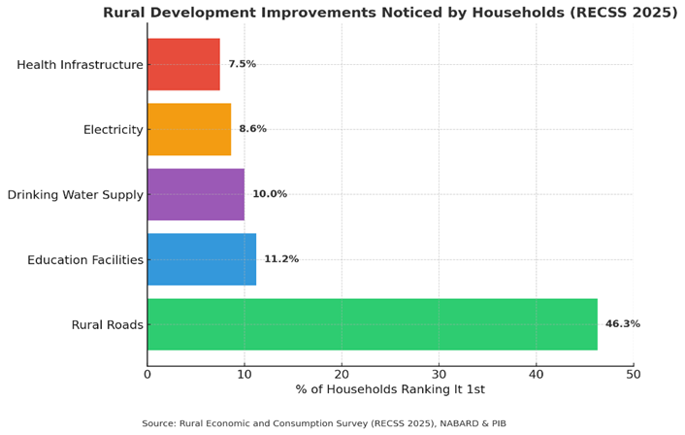
Market Linkages
Agricultural production supports FMCG, food processing, and exports.
Rural consumption growing faster than urban in FMCG and durables.
PMGSY (Pradhan Mantri Gram Sadak Yojana): Connected over 97% of eligible rural habitations with all-weather roads.
Saubhagya Scheme: Brought electricity to 26 million rural households, as of 2023, 100% villages are electrified

Slide 15
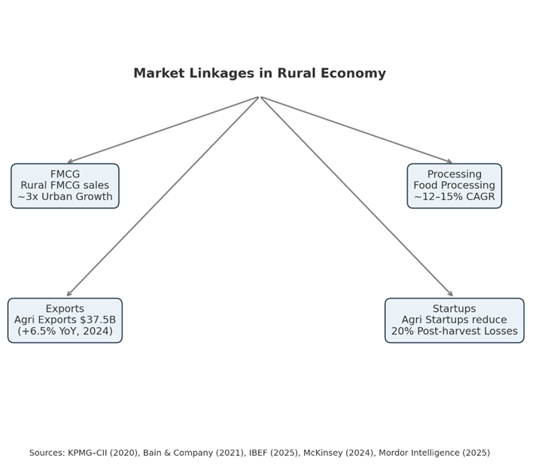
Market Linkages
Exports of cereals, spices, and coffee expanding. Depend on road corridors and logistics to ports.
Agritech startups improving efficiency and reducing losses.
Utilising both digital connectivity and reliable electricity for tech-based solutions.

Slide 16
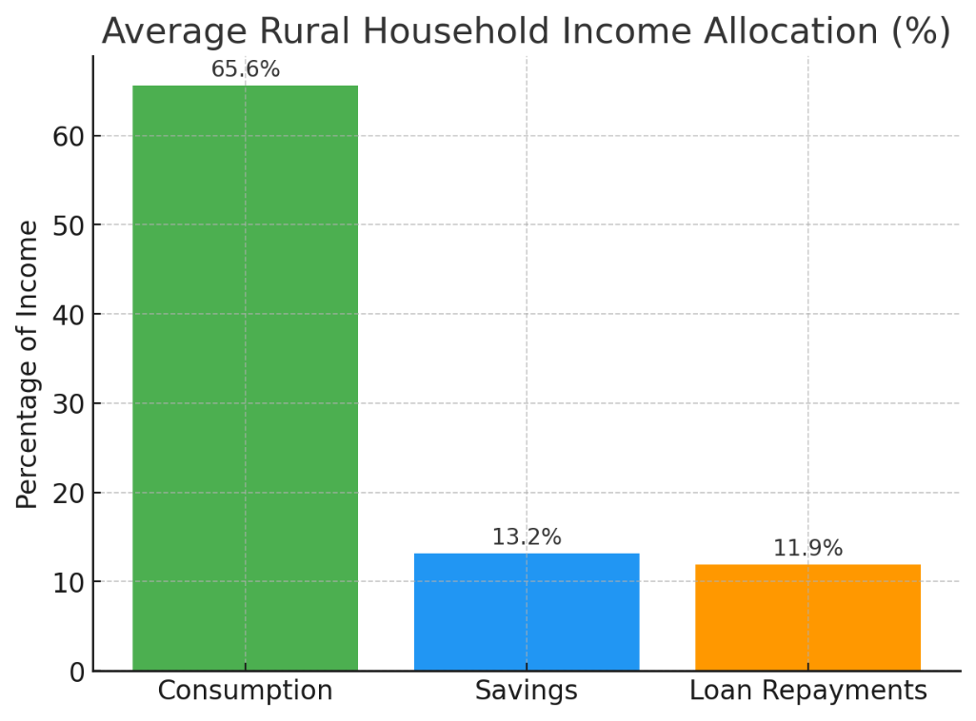
Rural Household Finances
On average, households allocate ~65% of income to consumption, ~13% to savings, and ~12% to loan repayments.
Digital finance adoption is rising, with UPI transactions exceeding card usage
Digital infra has created new business models — fintech (BNPL, micro-credit), eNAM (1,260 mandis), and rural e-commerce platforms

Slide 17
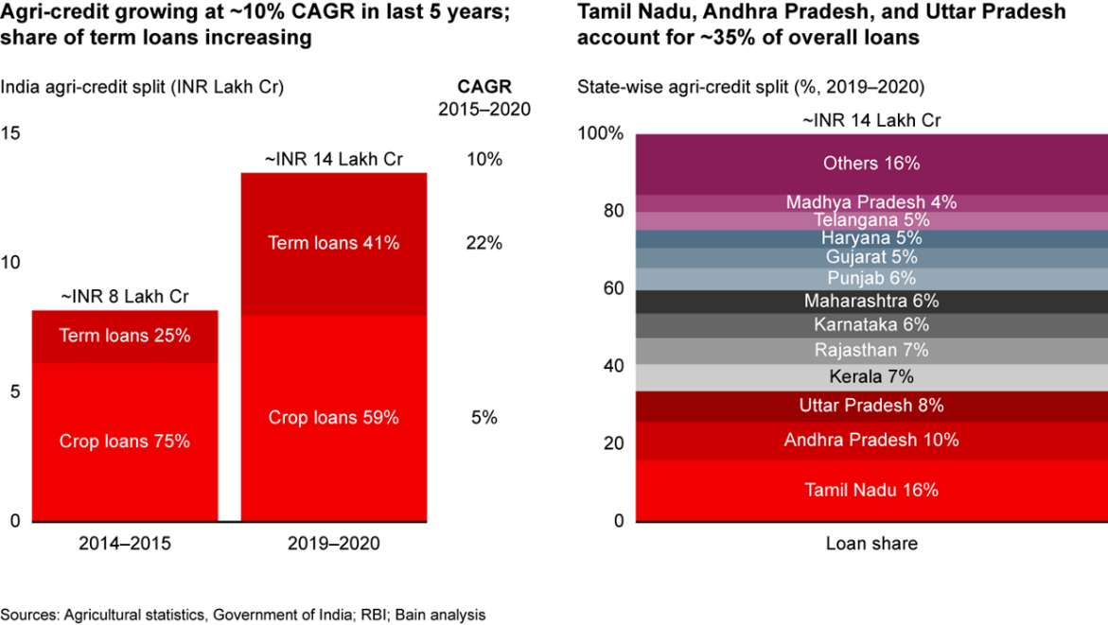
Rural Household Finances
Over half of rural households now rely solely on formal credit institutions.

Slide 18
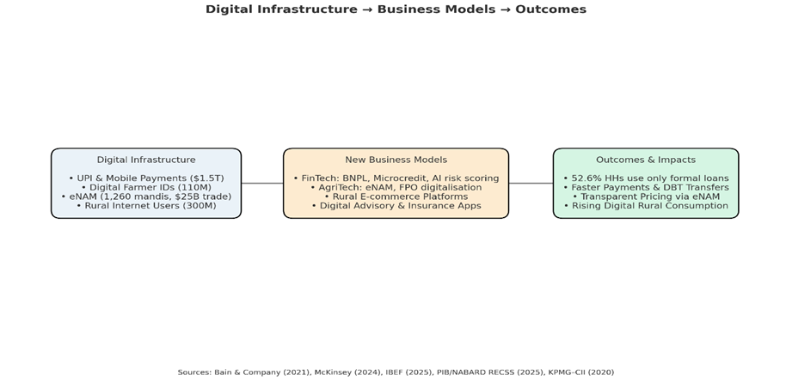
Digital Developments: Current and Future
Digital finance adoption is rising, with UPI transactions exceeding card usage
Internet Penetration: Over 300 million rural internet users.
UPI adoption: Rural digital payments grew faster than urban, with UPI > credit/debit cards.
Digital infra has created new business models — fintech (BNPL, micro-credit), eNAM (1,260 mandis), and rural e-commerce platforms.

Slide 19
Digital Developments: Current and Future
Present: Large-scale internet penetration, UPI-enabled transactions, and digital farmer IDs.
Opportunity: CAs & institutions can design risk frameworks, monitor compliance, and enable responsible scaling.
Definition: Digital-first credit systems: UPI micro-credit, Buy-Now-Pay-Later models for rural households.
Status: UPI > credit cards in value; BNPL pilots in rural consumer durables & agri-inputs.
Impact: Expands consumption power; builds transaction history for rural borrowers.
Gap: Risks of over-indebtedness; weak credit scoring for first-time borrowers.

Slide 20
Women’s Participation in Rural Economy
Women are the silent drivers of rural labour, but remain excluded from opportunity.
LFPR fell to 25%.
Gaps in access to credit and finance remain significant at ₹13.7 lakh crore.
Financial inclusion is shallow - High account ownership (79%), but account inactivity remains high (32%).
Women-led MSMEs are massively underfinanced relative to their share.
Skewed Market Orientation
Losing space in the labour market due to mechanisation and social constraints.
Market structures see women more as end-consumers than producers or entrepreneurs.
Persistent social, mobility, and digital barriers limit participation in higher-value activities.

Slide 21
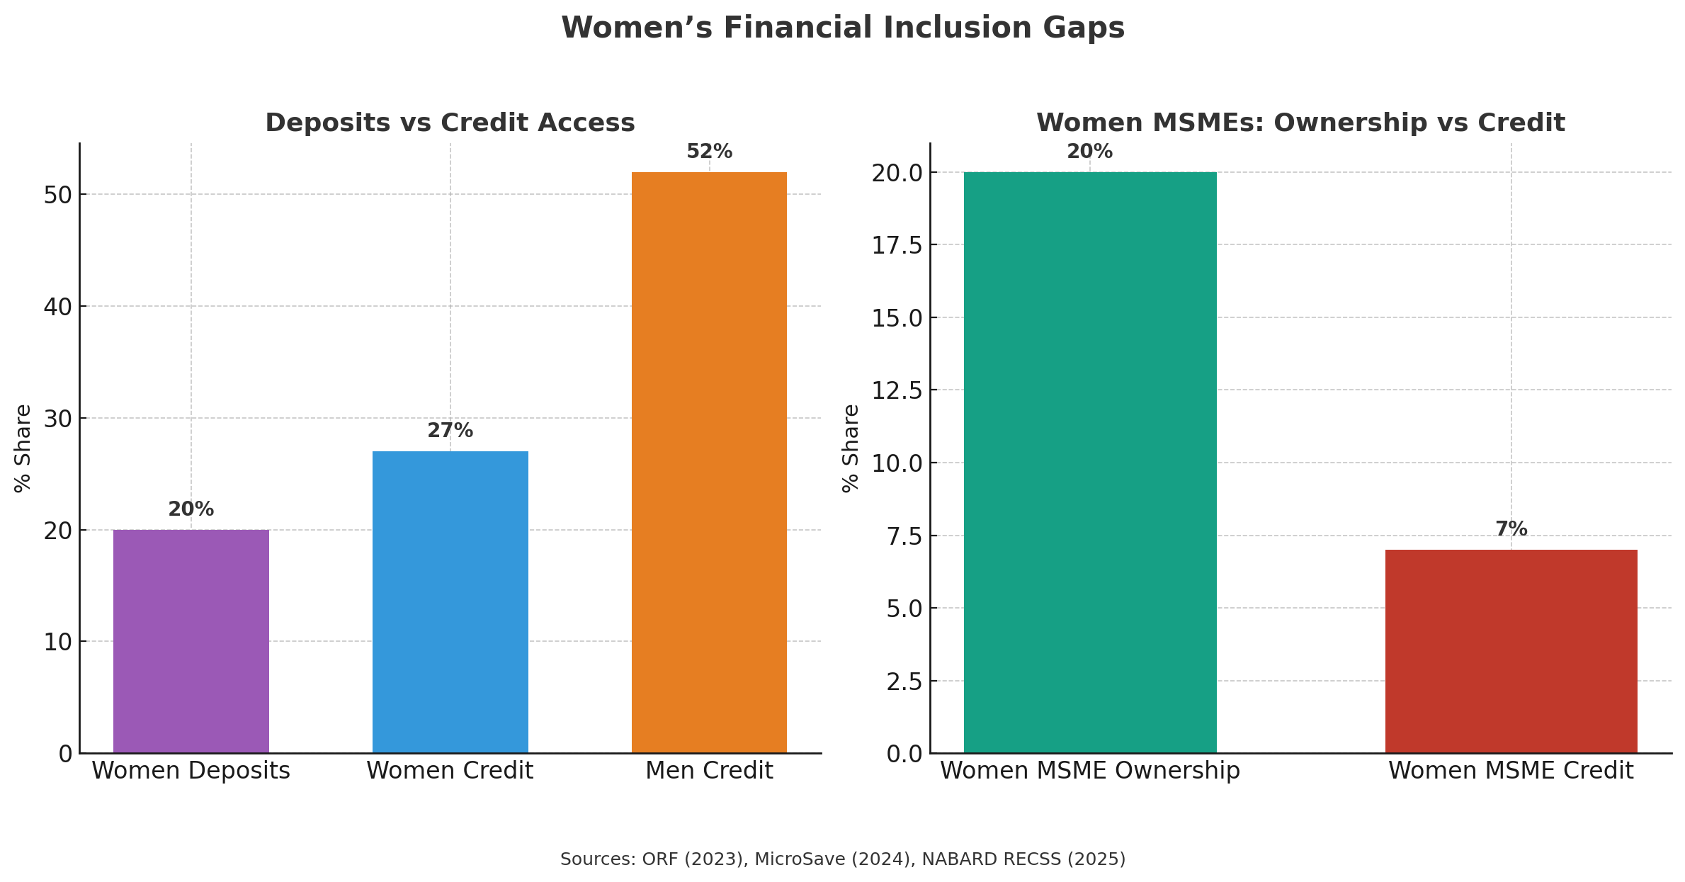

Slide 22

Section 3 Rapid Sectoral Growth and Inequalities

Slide 23
Fastest Growing Segments
Fruits & vegetables, organic farming, processed foods, biofuels, and Agri-biologicals show strong growth prospects.
Organics
Farming without synthetic fertilisers, pesticides, or GM seeds.
Drivers: Urban demand, exports (US/EU), Govt schemes: PKVY, Mission Organic Value Chain Development for North Eastern Region (MOVCDNER)
Market: Growing at 25% CAGR (till 2027).
Opportunity: Premium pricing, export growth, sustainability + carbon credits.
Agri biologicals
Biological alternatives to synthetic inputs (biofertilizers, biopesticides, bio stimulants).
Drivers: Climate concerns, environmental regulations, export demand.
Market: 9–10% CAGR; expected $600–640M by 2030.
Opportunity: Eco-friendly input diversification, opens new compliance space (environmental audits).

Slide 24
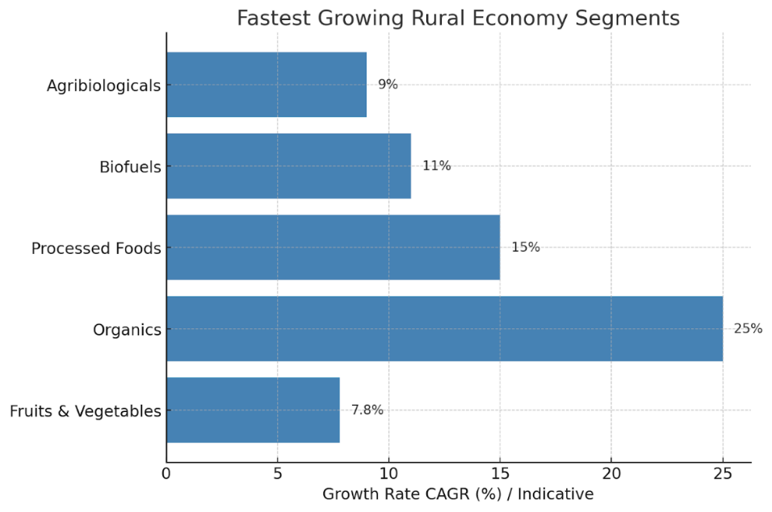
Carbon Credits in Farming
Tradable permits earned by farmers adopting regenerative/organic practices that cut emissions.
Status: Pilot projects in 8 states; emerging market.
Market Value: Untapped, but global credits trading at $5–15/ton CO₂.
Opportunity: New income source for smallholders; requires verification, carbon accounting, financial audits.

Slide 25
Persistent Inequalities
Productivity gaps between urban and rural workers persist and are widening.
Regional Variations: Mechanisation high in Punjab/Haryana, low in NE/Bihar.
Infrastructure bottlenecks like cold chains lead to massive income losses for smallholders. Post-harvest losses ~40% produce, ~$13B annually.
Gender and credit gaps remain wide.
Collective models like FPOs and SHGs show promise but remain underdeveloped, limiting their ability to reduce inequality.

Slide 26
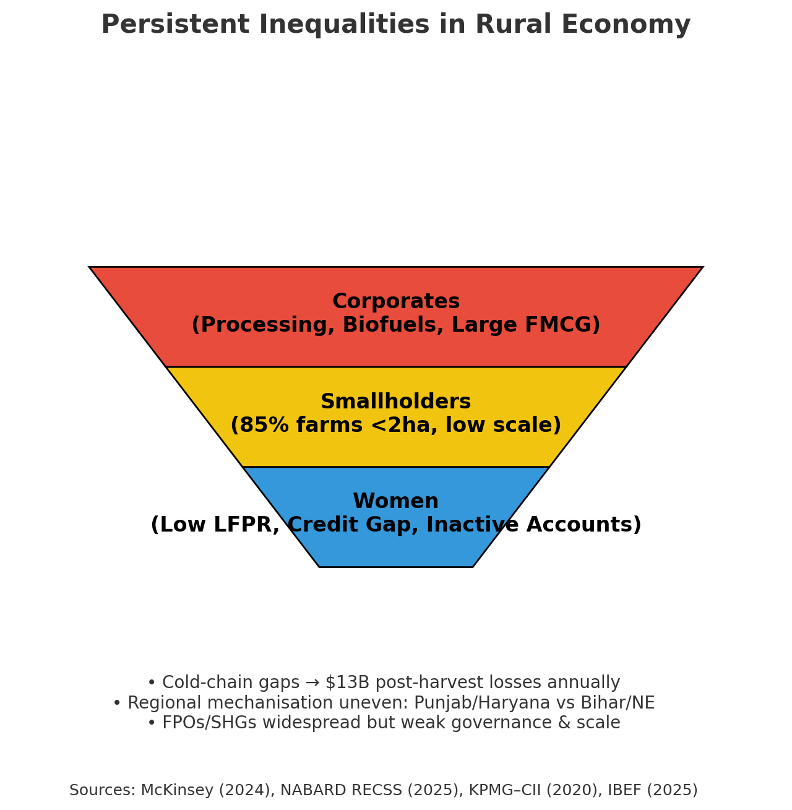
Persistent Inequalities

Slide 27
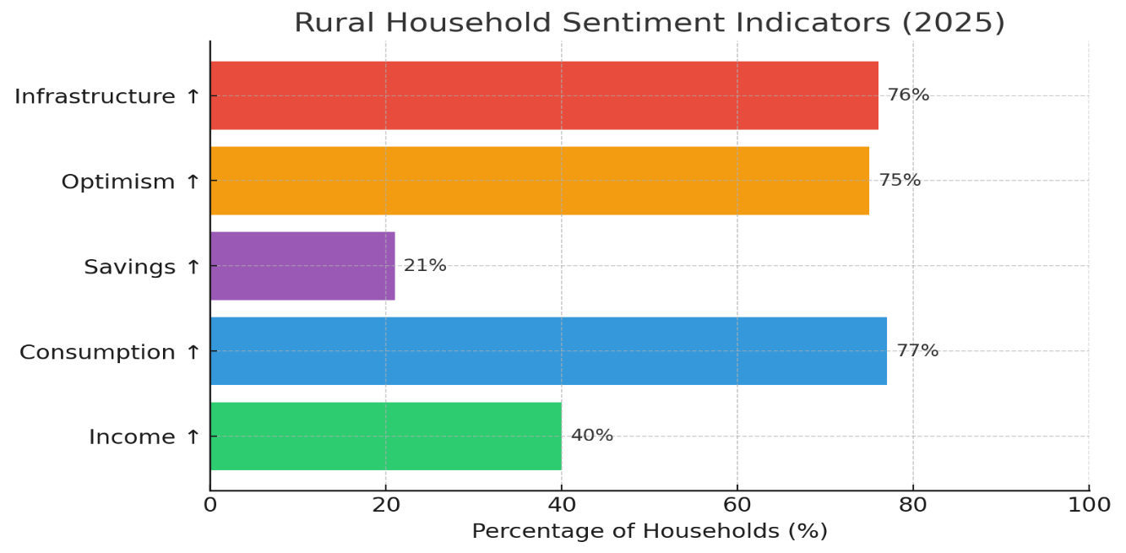
Household Sentiments (2025 Survey)
~40% report higher incomes; ~77% report higher consumption.
Savings and loan repayments rising alongside formal credit adoption.
Majority expect higher incomes and better jobs in the near future.
Infrastructure improvements widely acknowledged.

Slide 28

Section 4 Implications for Stakeholders

Slide 29
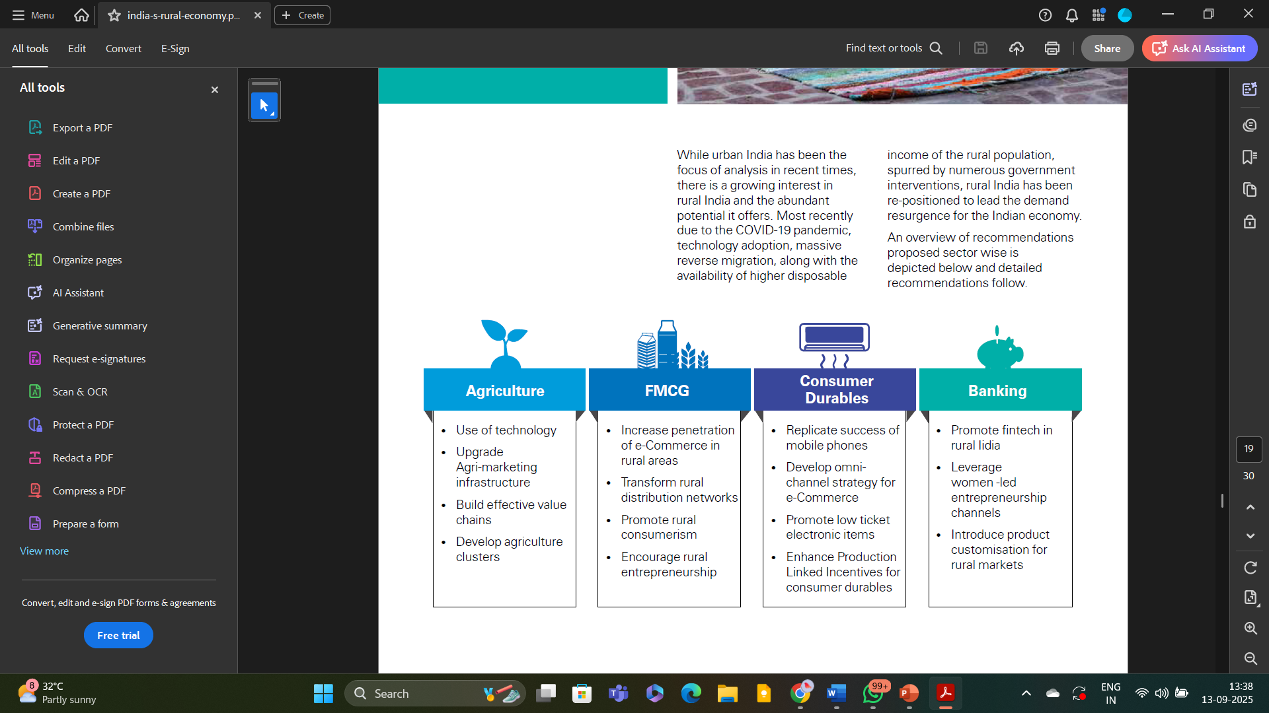
Implications for Policy Makers, Institutions & CAs
Rising incomes and consumption diversification.
But inequalities persist — gender, regional, sectoral.
Aspirations are rising faster than employment opportunities.
Source: KPMG,2020

Slide 30
Implications for Policy Makers, Institutions & CAs
Cold-Chain & Post-Harvest Infra
Definition: Storage, refrigerated transport, and packhouses for perishable crops.
Status: Only 4% of perishables in India covered by cold chain; 40% of produce lost annually (~$13B).
Impact: Major cause of farmer income inequality, food inflation.
Opportunity: Investments need audits, PPP project finance, and compliance checks.
Priorities: cold-chain, mechanisation, women’s credit, rural infrastructure.
New opportunities: organics, carbon credits.
Ensuring inclusivity requires targeted interventions.

Slide 31
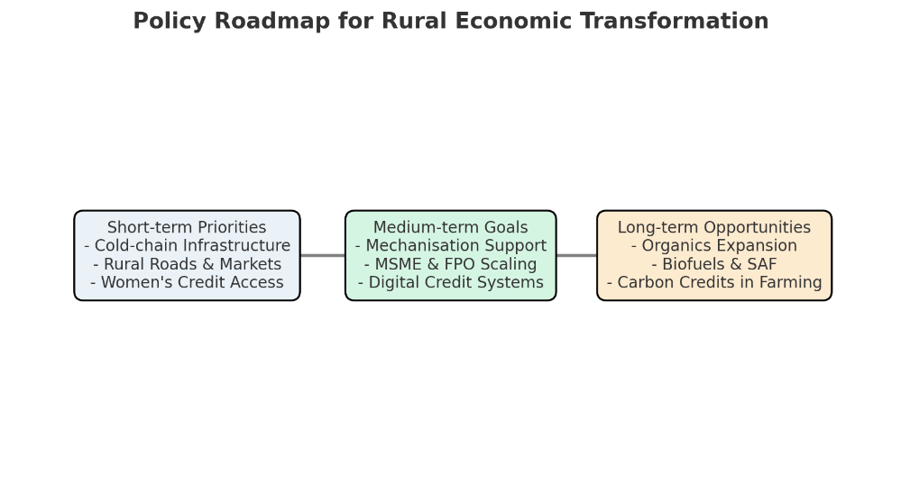
Implications for Policy Makers, Institutions & CAs
Compliance & advisory in food processing, fintech, FPOs/MSMEs.
New frontiers: carbon credit accounting, BNPL compliance, export finance.
Rural = the next compliance frontier.

Slide 32
Implications for Policy Makers, Institutions & CAs
SHGs (Self-Help Groups)
Community-based savings & credit groups, often women-led.
Status: 70+ lakh SHGs covering ~7.9 crore households (DAY-NRLM, 2024).
Impact: Key in women’s financial inclusion, microfinance access.
Gap: Remain small-ticket; rarely scale up to MSME-level operations.
Opportunity: SHGs need transition support into enterprises; CAs can design scalable credit structures.
FPOs (Farmer Producer Organisations)
Farmer collectives pool resources for inputs, marketing, and processing. Status: 10,000 FPOs being promoted under the Govt scheme.
Impact: Increases bargaining power, lowers transaction costs, enables value addition.
Gap: Many remain weak in governance/finance; uneven maturity.
Opportunity: CAs can assist with compliance, audits, and financial structuring.

Slide 33


Shifting Landscapes = Shifting Opportunities
Rural India is becoming diverse, digital and
aspirational.

Slide 34
REFERENCES
Bain & Company. (n.d.). Innovation in India’s rural economy. Bain & Company. https://www.bain.com/insights/innovation-in-indias-rural-economy/
Department of Rural Development. (2024, February). Annual report 2023–24. Ministry of Rural Development, Government of India. https://www.dord.gov.in/static/uploads/2024/02/43f6d3ecbd0cf21b1a0c23d80d270e0c.pdf
India Brand Equity Foundation. (n.d.). Agriculture in India. IBEF. https://www.ibef.org/industry/agriculture-india
IMARC Group. (n.d.). Agriculture industry in India 2024–2029. IMARC Group. https://www.imarcgroup.com/agriculture-industry-in-india
IMPRI. (2020, October 30). NRETP and India’s rural economy. IMPRI Impact and Policy Research Institute. https://www.impriindia.com/insights/nretp-rural-economy/
KPMG India. (2020, December). India’s rural economy: Driving inclusive growth. KPMG. https://assets.kpmg.com/content/dam/kpmg/in/pdf/2020/12/india-s-rural-economy.pdf
McKinsey & Company. (n.d.). Value creation in Indian agriculture. McKinsey & Company. https://www.mckinsey.com/industries/agriculture/our-insights/value-creation-in-indian-agriculture
Microsave Consulting. (2024, September 24). The silent shortfall: Why women’s savings don’t translate into equal credit. Microsave. https://www.microsave.net/2024/09/24/the-silent-shortfall-why-womens-savings-dont-translate-into-equal-credit/
Mordor Intelligence. (n.d.). Agriculture industry in India. Mordor Intelligence. https://www.mordorintelligence.com/industry-reports/agriculture-industry-in-india
National Rural Livelihoods Mission. (n.d.-a). National rural economic transformation project (NRETP). Aajeevika. https://aajeevika.gov.in/what-we-do/national-rural-economic-transformation-project
National Rural Livelihoods Mission. (n.d.-b). Start-up Village Entrepreneurship Program (SVEP). NRLM. https://svep.nrlm.gov.in/landing
Observer Research Foundation. (n.d.). Financial inclusion of women: Current evidence from India. ORF. https://www.orfonline.org/research/financial-inclusion-of-women-current-evidence-from-india
Press Information Bureau. (n.d.). Factsheet: Rural development. Government of India. https://www.pib.gov.in/FactsheetDetails.aspx?id=149227&NoteId=149227&ModuleId=16
Press Information Bureau. (2024, June 12). Press release: Government initiatives on rural economy. Government of India. https://www.pib.gov.in/PressReleaseIframePage.aspx?PRID=2100410
Chand, R., Srivastava, S. K., & Singh, J. (2017). Changing structure of rural economy of India: Implications for employment and growth (Discussion Paper). NITI Aayog. Retrieved from https://www.niti.gov.in/sites/default/files/2021-08/11_Rural_Economy_Discussion_Paper_0.pdf
Ohlan, R. (2016). Rural transformation in India in the decade of miraculous economic growth. Journal of Land and Rural Studies, 4(1), 162–182. https://doi.org/10.1177/2321024916640110

Slide 35
Thank You!
Prof. Vidya Vemireddy
Indian Institute of Management Ahmedabad
vidyav@iima.ac.in

