Slide 1




WOMEN IN AGRIBUSINESS
Challenges & Opportunities
Report Findings & Recommendations
Prof. Vidya Vemireddy
Indian Institute of Management Ahmedabad
21 March 2025

Slide 2

The Paradox of Presence and Absence
Periodic Labour Force Survey (PLFS) data shows that women comprise
64.4% of India's agricultural workforce (2023-24).
The Education-Employment Disconnect:
  Women in Agricultural Education: ~40%, yet this doesn’t translate well into formal agribusiness employment.
  Women in Permanent Roles: 6.35%
Our study reveals both critical challenges and strategic opportunities for the sector.

Slide 3
Why This Matters Now
Business Impact and Opportunity
  Field roles constitute a significant portion of agribusiness positions
  Critical market intelligence is lost when companies lack female representatives in rural communities
Organizations addressing these barriers gain measurable advantages:
  Expanded talent pools for difficult-to-fill positions
  Stronger rural community connections through representative field teams
  Improved retention across critical transition points

Slide 4
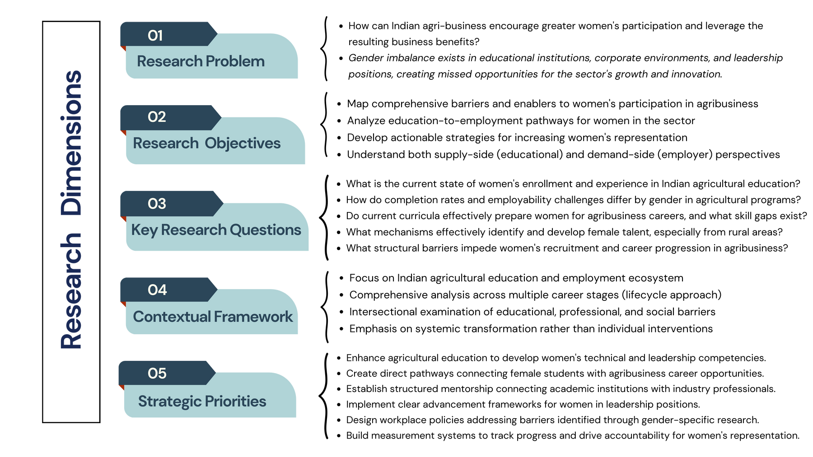
Methodology Overview
Methodological Approach:
A value chain analysis examining barriers across the agricultural ecosystem, from input suppliers to market actors
Lifecycle approach to women's career progression, analyzing critical transition points where female talent exits the pipeline

Slide 5
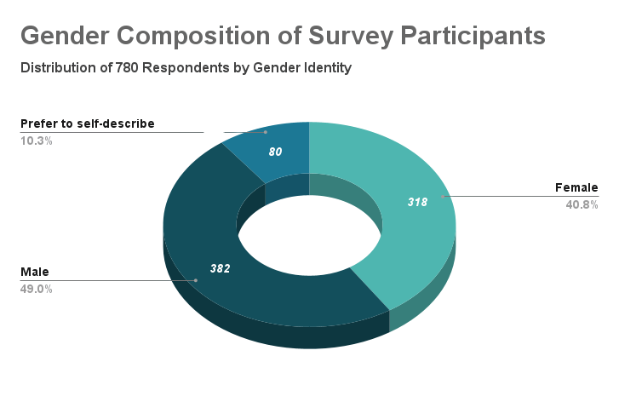
Methodology Overview
Our mixed-methods approach combined:
  Quantitative Analysis:
  AISHE data for educational landscape trends
  BRSR for corporate representation patterns
  Surveys reaching 780 respondents across educational institutions
  Qualitative Research:
  Focus Group Discussions with students across agricultural colleges
  In-depth interviews with faculty members and agribusiness leaders
  Expert consultations with industry professionals & leaders
  Panel discussions and stakeholder dialogues providing nuanced insights from diverse perspectives
(40.8% female, 49.0% male, 10.2% self-described gender)
505 students in agricultural education programs
93 female working professionals

Slide 6
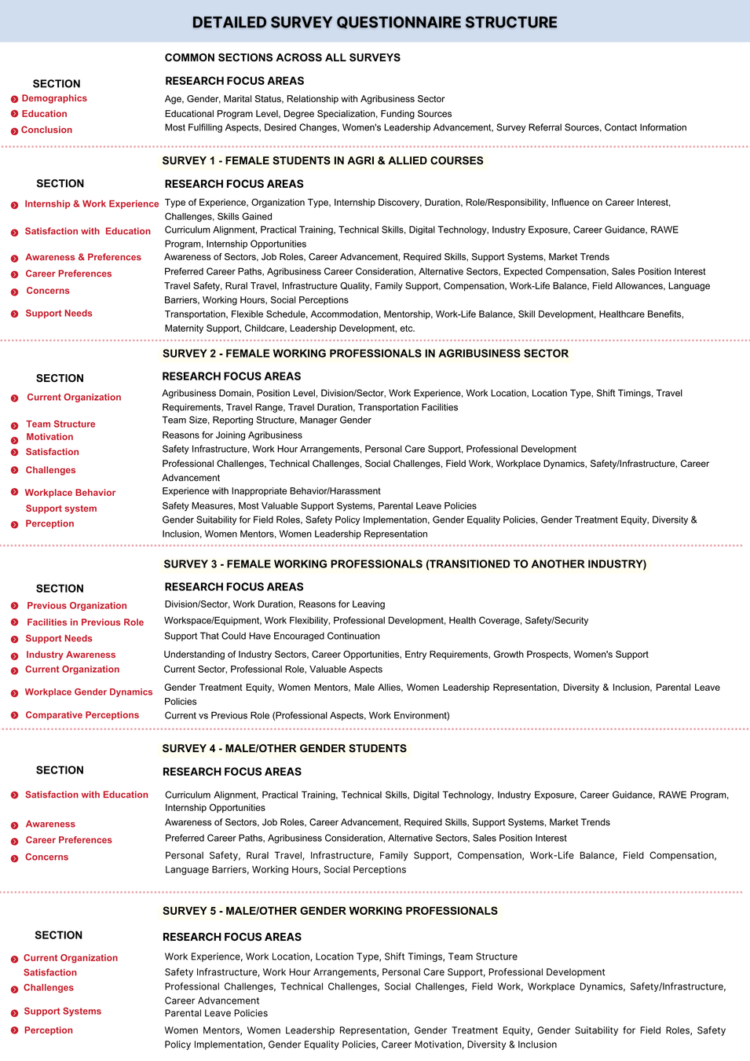
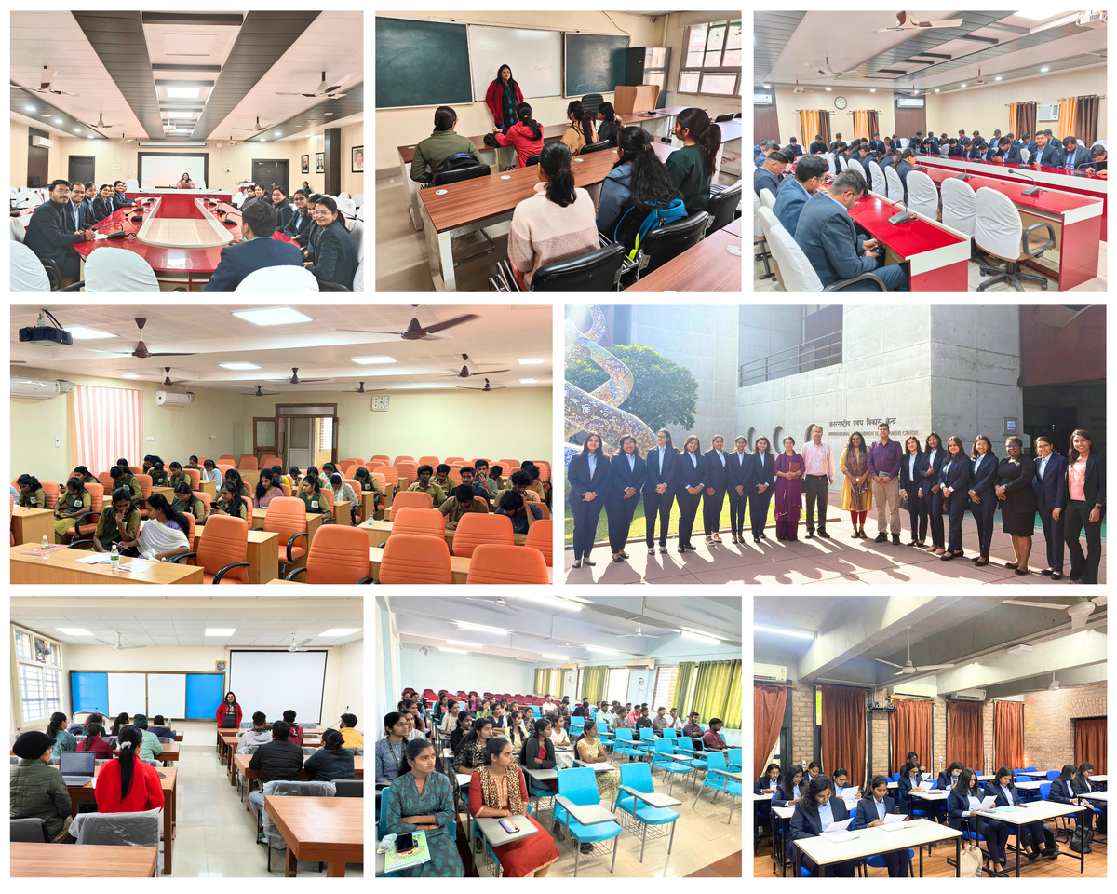
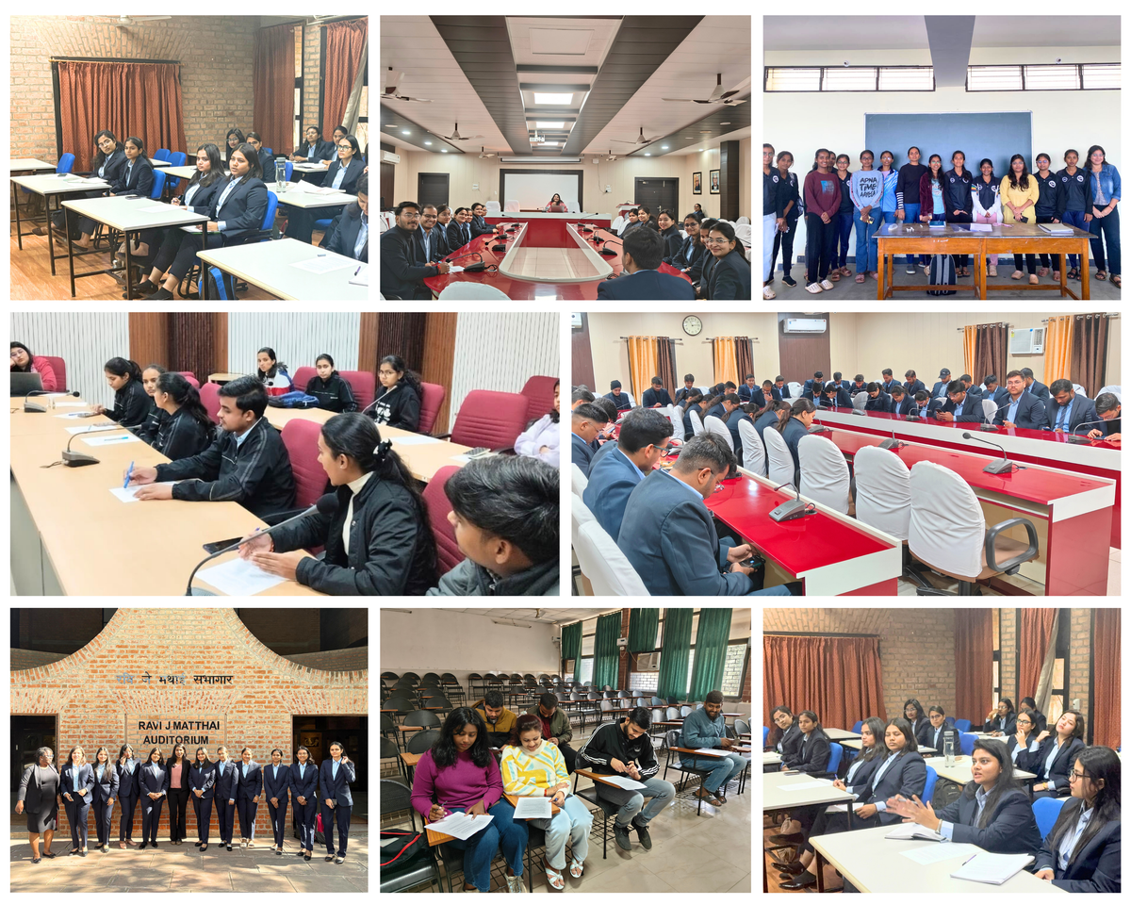
Capturing Voices: Our Research Methodology in Action

Slide 7
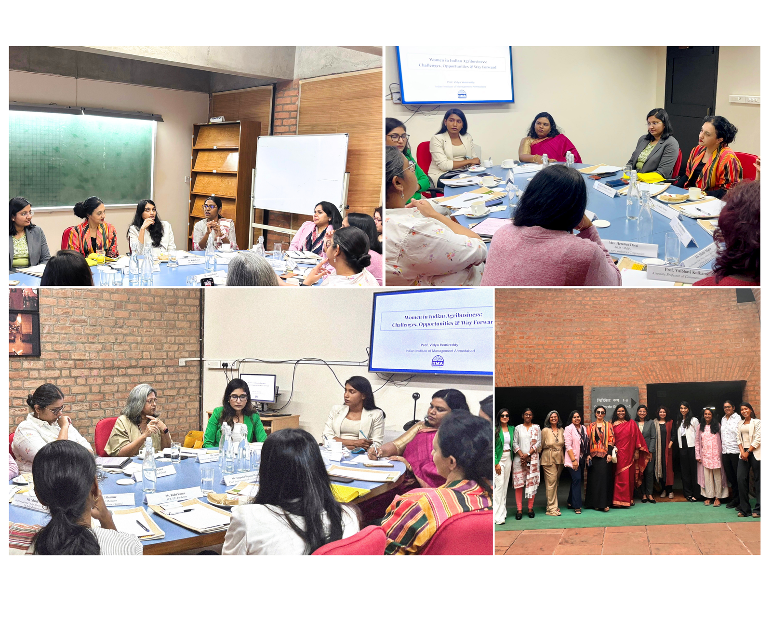
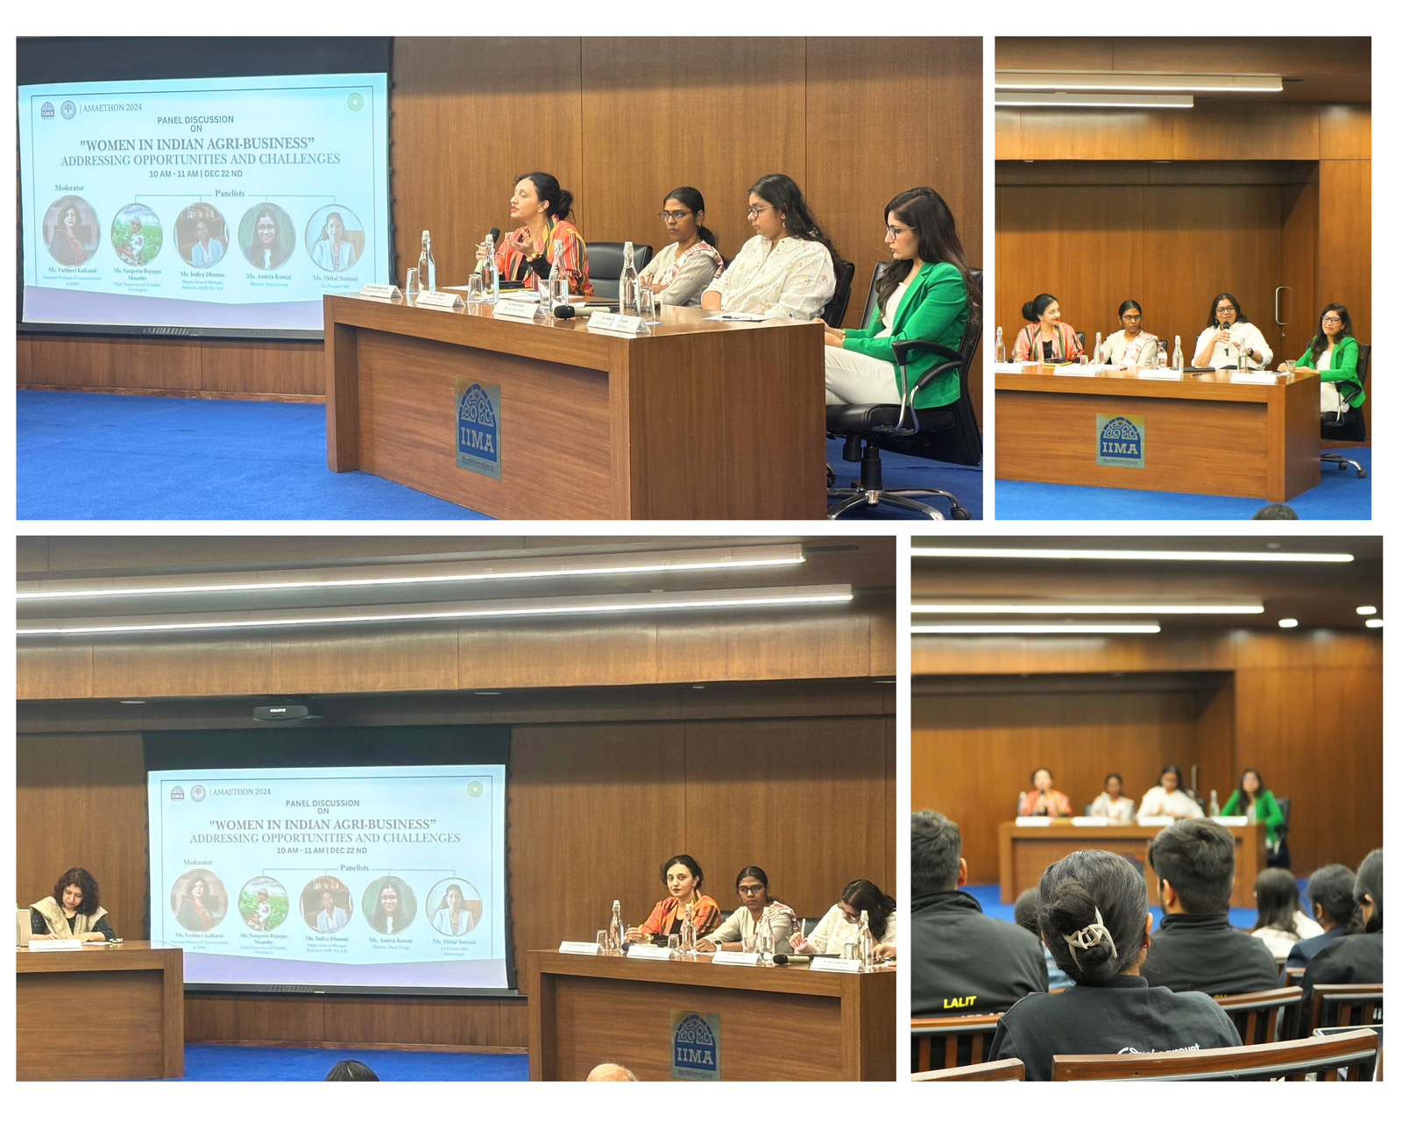
Capturing Voices: Our Research Methodology in Action
Panel Discussion & Stakeholder Dialogue
22nd December 2024, IIM Ahmedabad

Slide 8
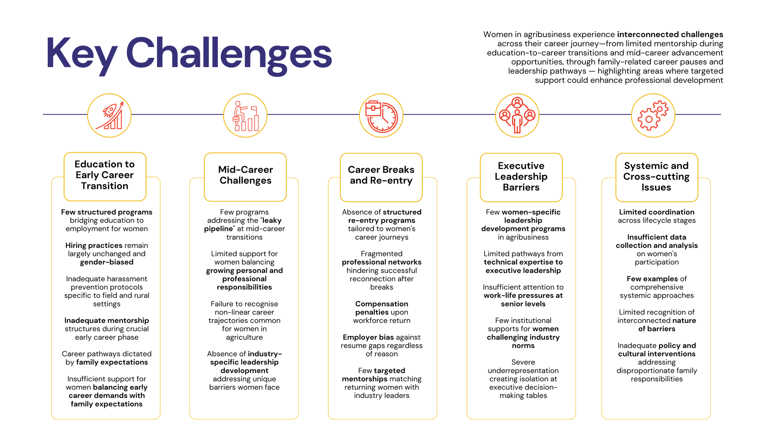
Key Challenges
Career Lifecycle Challenges: Systemic Barriers to Women's Advancement
Women in agribusiness experience interconnected challenges across their career journey—from limited mentorship during education-to-career transitions and mid-career advancement opportunities, through family-related career pauses and leadership pathways — highlighting areas where targeted support could enhance professional development

Slide 9
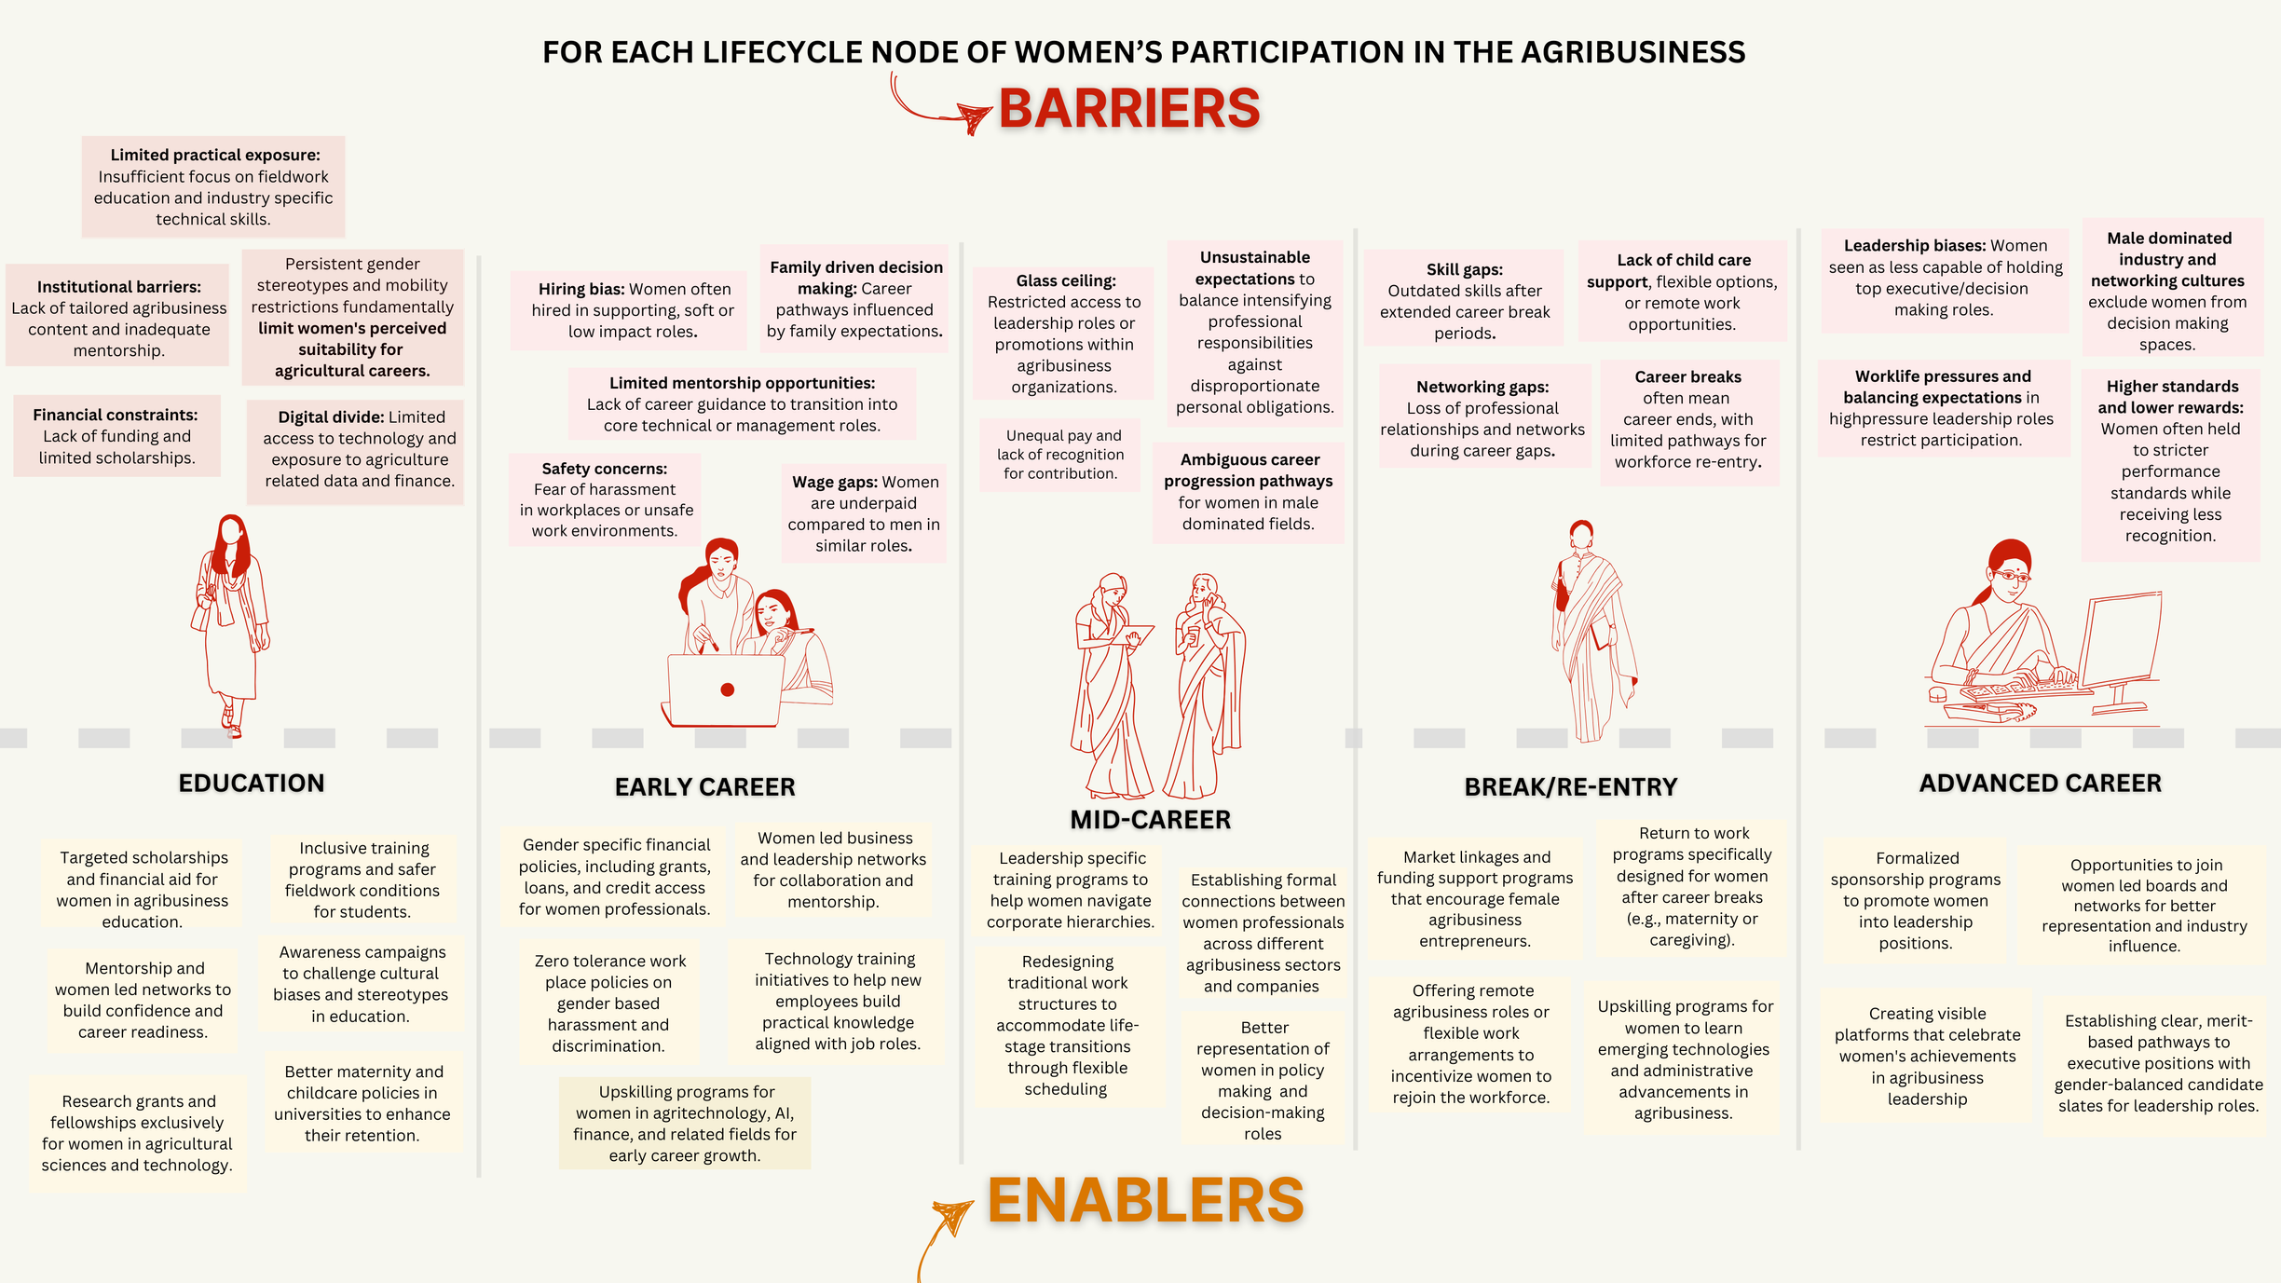
Barriers and Enablers

Slide 10
  Women face compounding challenges that intensify at each career stage—from limited field exposure and biased recruitment initially, to rigid work structures incompatible with caregiving responsibilities mid-career, with a significant portion citing gender bias as extremely challenging to their advancement.
  The agribusiness sector is experiencing substantial talent migration, with most women who transition to other industries reporting improved professional circumstances, revealing a significant retention challenge linked to inadequate career advancement pathways within the sector.
  Leadership opportunities remain severely constrained, with minimal female representation in key management positions, creating a self-reinforcing cycle where women lack both role models and decision-making influence to transform organizational cultures.

Slide 11
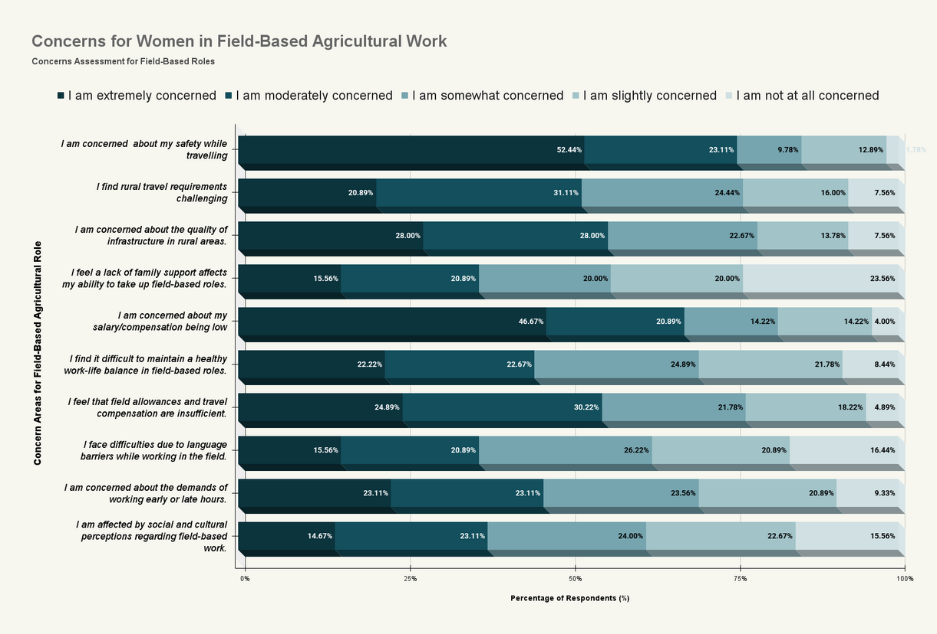
Findings
  Safety during travel is the predominant concern with over 50% extremely concerned, creating a fundamental barrier to field-based careers.
  Compensation inadequacy ranks second (45% extremely concerned), indicating economic barriers compound safety concerns.
  Rural infrastructure quality concerns (28% extremely concerned) reflect practical operational challenges rather than just cultural barriers.
Female Students' Concerns About Field-Based Agricultural Roles

Slide 12
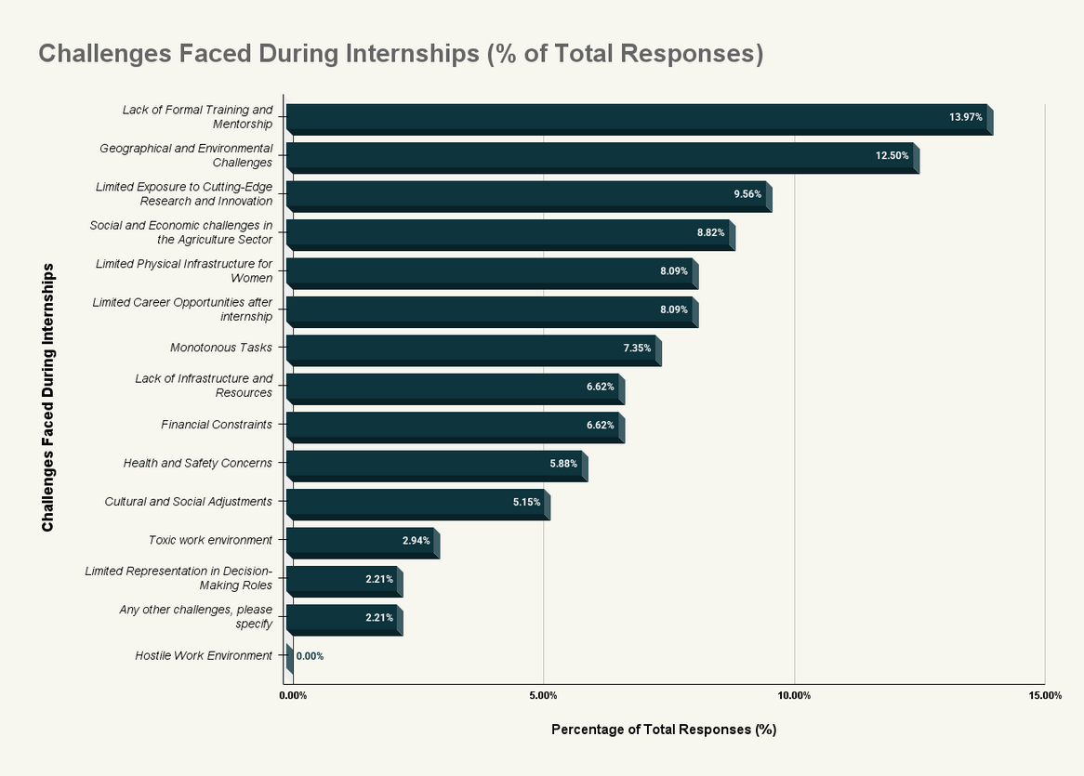
Findings
  Lack of formal training and mentorship (13.97%) is the top internship challenge, suggesting structural gaps in educational-to-professional transitions.
  Geographical and environmental constraints (12.50%) create physical barriers that disproportionately affect women's professional development.
  Limited exposure to cutting-edge practices (9.56%) indicates female interns may receive lower-quality professional experiences than male counterparts.
Challenges Faced by Female Interns in Agribusiness

Slide 13
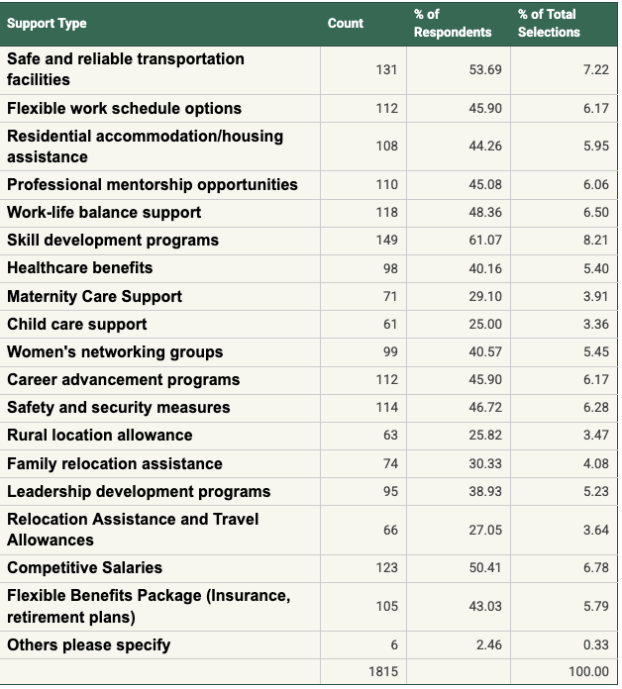
Findings
Support Systems That Would Encourage Women to Pursue Agribusiness Careers
  Skill development programs (61.07%) and safe transportation (53.69%) emerge as the highest priorities, combining professional growth with practical safety needs.
  Work-life integration mechanisms (clustered around 45-48%) are viewed not as accommodations but as strategic enablers for sustainable careers.
  Career development supports (45-46%) rank significantly higher than family-specific supports (25-29%), challenging stereotypes about women's professional motivations.

Slide 14
Workforce Composition Analysis
Gender Distribution in Agribusiness:
  Permanent Employees: 6.35% women
  Temp/Contract: 9.39% women
  Management: 12.99% women
  Board Members: 20.36% women
Female representation increases slightly in board positions due to regulatory mandates, but operational leadership remains dominated by men.
Key Workforce Insights:
Sticky Floor Phenomenon: Women remain concentrated in temporary positions (13% vs 7.58% in permanent roles), suggesting systemic barriers to securing stable employment.

Slide 15
Success Stories - Transformative Initiatives
Leading companies demonstrate transformative approaches: Bayer's Samavesh Initiative combines academic and field training with safety modules, UPL's Women in Agriculture employs women as field partners (Krishi Mitras), Mahindra's SOAR Program offers structured returnships for mid-career women, and Tata's Women in Blue Initiative dramatically increased female manufacturing representation through specialized skills development.

Slide 16
Strategic Recommendations - Immediate Actions
  Bridge the Education-Employment Gap: Establish direct partnerships with 3-5 agricultural universities. Create detailed role profiles with explicit skill requirements. Implement inclusive recruitment language and imagery. Develop virtual field experience modules.
  Implement Region-Specific Field Role Pilots: Identify 2-3 states with higher cultural acceptance of women in professional roles. Create women-focused field teams with cluster-based deployment. Target mid-career women with managerial experience from other sectors. Conduct mandatory gender sensitization workshops for all employees.
  Stakeholder Actions: Educational Institutions should strengthen collaboration with employers to support women's recruitment. Employers need to strengthen outreach efforts to attract women to agricultural careers. Policy Makers must adopt targets for women's participation in technical and managerial roles.

Slide 17
Bridging the Education-Employment Gap
Complementary Learning Models for Agribusiness Workforce Development - Part 1
Germany's Dual Vocational Training System: A Model for Skills Development
Germany's dual vocational training system stands as a global benchmark for workforce development, combining theoretical knowledge with practical application. Students spend 1-2 days at vocational schools learning technical foundations, while remaining days are dedicated to hands-on training at partner companies. This structure creates job-ready professionals who receive monthly stipends averaging €1,066 throughout their 2-3.5 year programs. With 328 recognized training pathways and excellent employment outcomes, this model has contributed significantly to Germany's strong manufacturing and technical sectors. Crucially, the system reduces skills mismatch between education and industry by directly involving employers in training design and delivery.
India's Student READY Program: A Comprehensive Framework for Agricultural Education
The Student READY (Rural Entrepreneurship Awareness Development Yojana) program, launched by India's Prime Minister in July 2015, represents a holistic approach to agricultural education focused on knowledge, skill, ability, and experience. Implemented across all agricultural universities in India (Central, State, ICAR Deemed Universities), it is a mandatory component for fourth-year undergraduate students in ten disciplines including Agriculture, Agricultural Engineering, Biotechnology, Dairy Technology, Fisheries, and Forestry. The program consists of five interconnected components: Experiential Learning with business mode (following "Earn while Learn" principles to develop entrepreneurial competence), Rural Agricultural Work Experience (exposing students to village settings and farm families), In-Plant Training/Industrial Attachment (providing industrial exposure), Hands-on Training (skill development), and Student Projects (developing analytical and problem-solving capabilities). Students receive monthly stipends of Rs. 3,000 for up to six months during their village/rural training phase. These interactive components are conceptualised to build skills in project development, decision-making, team coordination, and end-to-end problem-solving approaches.
Bridging Educational Models for Comprehensive Workforce Development
While Student READY provides excellent rural and entrepreneurial exposure, incorporating elements of Germany's employer-integrated approach would strengthen students' readiness for formal employment in agribusiness companies. By expanding the In-Plant Training component with more structured company-based training similar to Germany's model, agricultural universities could forge stronger links with employers while equipping graduates, particularly women, with industry-specific skills and professional networks. This hybrid approach would address the dual needs of developing both entrepreneurial capacity and employability skills, creating versatile agricultural professionals who can navigate various career pathways.
Recommendation: The Student READY framework already provides an excellent foundation that could be enhanced through formal partnerships with agribusiness employers, particularly focusing on women students' participation in industrial attachments with companies committed to gender inclusion like those featured in Chapter 7.
Source: Federal Ministry for Economic Affairs and Climate Action, 2024; Indian Council of Agricultural Research, 2024; Agricultural Education Portal, ICAR, 2024.
Complementary Learning Models for Agribusiness Workforce Development - Part 2
"AgriLaunchpad": An Industry-Integrated Final Semester
Recommendations for Business-Education Integration:
For agribusiness companies seeking to address talent gaps while promoting gender inclusion, we recommend creating formalized Student READY partnership programs modeled after Germany's dual training approach. Companies can:
  Develop structured 6-month industrial attachments with defined learning outcomes, reducing training costs for entry-level positions while creating pre-assessed talent pipelines
  Establish "Women in Agribusiness" tracks within these programs, offering specialized mentorship and leadership development for female students
  Create co-funded scholarship programs with agricultural universities that guarantee industrial placement, building brand loyalty while addressing diversity goals
  Design competency certification programs aligned with industry needs that participants can earn during their attachment period, enabling direct recruitment of qualified, pre-trained candidates
These business-education partnerships would address recruitment challenges and diversity goals while giving companies direct input into agricultural curricula development—creating a self-reinforcing ecosystem that produces work-ready professionals tailored to industry needs.

Slide 18









Strategic Implementation Priorities
Establish a founding consortium of agribusiness companies to coordinate strategic initiatives
Industry-Academic
Partnership Council:
Cross-Company
Mentorship Ecosystem:
ELEVATE Leadership Program:
WHY: Systematic biases in advancement pathways perpetuate leadership underrepresentation despite proven capabilities.
Comprehensive development initiative accelerating advancement through transparent metrics, sponsorship mechanisms, and leadership development tailored to women's career journeys.
WHY: Traditional educational models fail to prepare women for field careers, creating immediate disadvantage upon workforce entry.
Standardized "finishing semester" programs that bridge theoretical knowledge with practical field skills, providing industry experience before graduation.
WHY: Professional isolation in male-dominated environments limits women's knowledge sharing and advancement opportunities.
Structured networks connecting women across company boundaries to share best practices, provide psychosocial support, and navigate career transitions.
Women in Agribusiness Infrastructure Fund:
Flexible Work Standards Initiative:
WHY: Individual companies lack resources to create comprehensive safety infrastructure, perpetuating women's exclusion from field roles.
Pooled resources developing standardized transportation, sanitation, and accommodation solutions that make field positions immediately accessible to women.
WHY: Mid-career attrition occurs when rigid work structures force women to choose between career progression and personal responsibilities.
Technology-enabled frameworks blending digital and on-site responsibilities to create sustainable, flexible career paths.

Slide 19
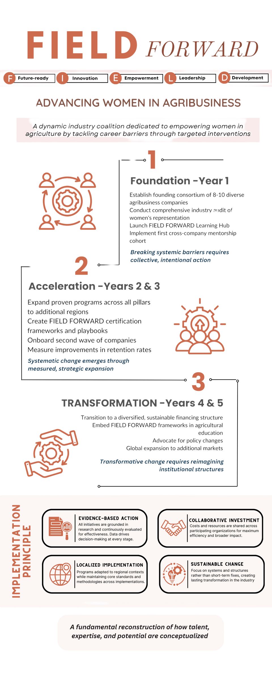
  FIELD FORWARD is a comprehensive industry-wide coalition that creates systemic change by targeting three critical transition points where women exit agribusiness careers.
  The initiative targets three critical career transition barriers through strategic interventions: structured university-to-field pathways, shared rural infrastructure for safety, and flexible work frameworks for mid-career retention.
  Companies pool resources to develop shared solutions like cross-organizational mentorship networks and rural infrastructure investments that would be impossible individually, driving both gender inclusion and business performance metrics including expanded talent acquisition, enhanced market intelligence, and increased innovation capacity.

Slide 20
Contrubutions & Acknowledgements for the Report
The conceptual development and implementation of this research initiative were made possible through the strategic vision and institutional support of the Godrej leadership team:
The methodological design and analytical rigor of this study were significantly enhanced through the contributions of:
Ms. Manasi Nair, Mr. Rahul Tejannavar, Mr. Shivam Rajput, Ms. Kirti Dutt, Ms. Navya Sharma, Ms. Shristi Sharma, Mr. Daksh Hirpara, Mr. Himanshu Murjani, Mr. Zuned Mansuri and Ms. Priyanka Sharma who provided essential support for data collection, interpretation, contextual analysis, development of insights and design of this report.
Prof. Vidya Vemireddy (Principal Investigator and Lead Author), Faculty Member, IIMA
Ms. Reema Lucia (Co-author and Lead Researcher) Research Associate, IIMA
Ms. Mallika Mutreja, Chief Human Resources Officer, Godrej Agrovet
Mr. Parmesh Shahani, Head, Godrej DEI Lab
Ms. Vidhi Verma, AVP Organisation Development, Godrej Agrovet
Ms. Supriya Nair, Head, Research & Media, Godrej DEI Lab
Ms. Prarthana Uppal, Lead - Diversity, Equity, and Inclusion, Godrej Agrovet

