Slide 1




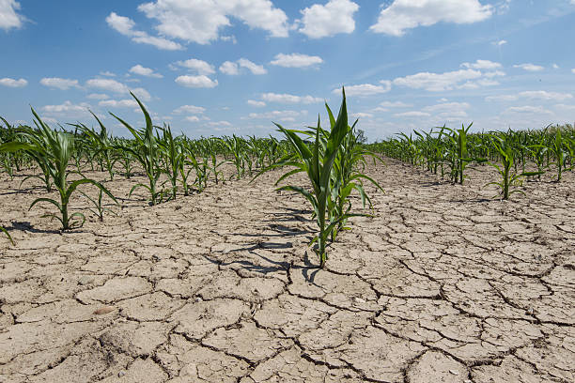
Strengthening Inclusive Solutions for Resilient and Nutri-Smart Drylands
Prof Vidya Vemireddy, Associate Prof, IIMA
Keynote Address | New Delhi | sep 12, 2026

Slide 2


Context & Vulnerability Landscape
Understanding the vital role of dryland ecosystems and the compounding risks of climate change and environmental degradation.

Slide 3



Drylands: Core of Rural Economy
Global & National Scale
The Rajasthan Context
41% of Global Land: Drylands account for 44% of cultivated land and up to 60% of world food production.
66% Agriculture Dependent: Over two-thirds of the population relies on agriculture under 15–35 cm annual rainfall.
2 to 3 Billion People: Depend directly on dryland ecosystems for their daily lives and livelihoods.
58% Female Workforce: Women constitute the vast majority of agricultural field labor in these dryland regions.
Vital Food Base: Far from marginal, drylands represent the backbone of global and Indian agricultural resilience.
Strategic Priority: Central to India's rural economy, food security, and gender-inclusive growth.

Slide 4




A Compound-Risk Landscape
Cascading Shocks
+0.7°C
1-3m
Climatic, environmental, and economic risks do not arrive in isolation—they compound each other.
WARMING SINCE 1901
GROUNDWATER DEPLETION / YEAR
A single drought triggers yield decline, income losses, distress migration, and heightened malnutrition across vulnerable communities.
10-45%
24B Tons
CROP YIELD LOSSES
GLOBAL TOPSOIL LOST / YEAR

Slide 5

Protecting the Most Vulnerable
Transitioning from calorie sufficiency to nutrition security through climate-adapted crops, soil revival, and landscape water retention.

Slide 6
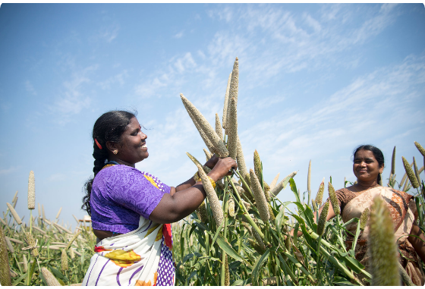

From Calories to Nutrition
Nutrition-Sensitive Security
  Underlying Burden: NFHS-5 reveals 57% female anaemia, 67% child anaemia, and 32% stunting despite a grain surplus.
  Women's Time Burden: Time-use data shows peak seasonal farm work creates severe trade-offs with meal prep and nutrient intake.
  Public Policy Shifts: Public distribution & mid-day meals must prioritize millets, pulses, and fortification over staple grains alone.
Source: www.icrisat.org
Research (Vemireddy & Pingali, 2021, Food Policy)
• High-frequency panel time-use data collected across ~1,000 rural women.
• Severe peak-season agricultural time trade-offs directly link to reduced maternal and child nutrient intake.
• Nutritional outcomes vary significantly by local cropping pattern and intra-household land ownership.

Slide 7









Adapted Inputs & Soil Health
Nutri-Smart Crops
Varietal Revival
Regenerative Soil
Millets & sorghum deliver superior protein, iron, and calcium per liter of water used compared to thirsty rice and wheat cultivars.
100,000+ farmers are actively cultivating over 1,000 native landraces across 200,000 hectares in ongoing biodiversity programs.
Zero-tillage increases organic soil carbon, while traditional Khadin structures boost dryland yield productivity by up to 70%.

Slide 8
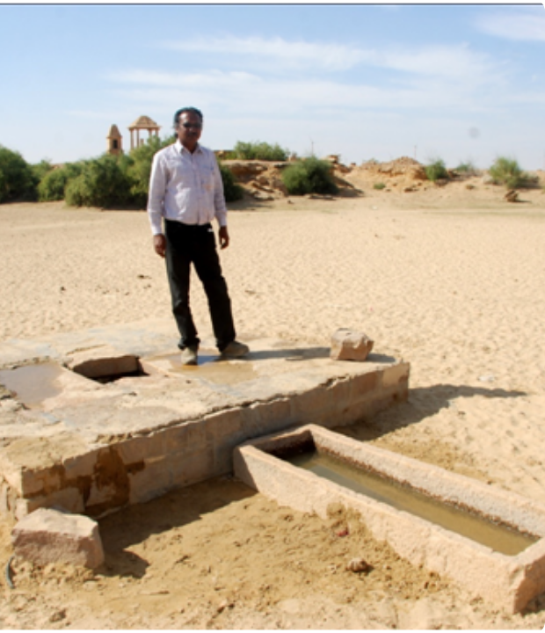
Water: Retention & Recharge
Beyond Deep Drilling
Agriculture accounts for ~70% of freshwater use. Solutions must focus on landscape retention and precision scheduling rather than deeper extraction.
Impactful Tech: On-farm sensor bundles cut water use by up to 86% without dropping yields. Traditional Khadins and Tankas remain key gendered infrastructure.
Overall Solution:
Adapted crop → Adapted production system → Accessible technology → Inclusive adoption → Resilient productivity
Source: vikalpsangam.org

Slide 9

Making Production Systems Resilient :
Gender Equity & Institutional Power
Correcting intra-household data erasure and institutionalizing Self-Help Groups (SHGs) as vital infrastructure for climate resilience.

Slide 10


Who Gets Counted & Served?
10%
11%
Intra-Household Erasure
AG INTERVENTIONS ACCOUNTING FOR GENDER
FEMALE-HEADED THAR HOUSEHOLDS
Collecting data strictly at the household level treats families as unified single decision makers, erasing women's labor and agency.
3.9%
3.0%
Digital agricultural registries (e.g., AgriStack) must capture land rights and decision rights accurately to prevent reinforcing historical inequities.
WOMEN IN INPUT DECISIONS
WOMEN MARKETING PRODUCE
Intersectionality Gap: Out of 26,000 reviewed climate-agri papers, only 243 (<1%) had any explicit focus on equity (caste + age + gender).

Slide 11
Women, SHGs and Local Institutions
The labour is already there. The institutional standing isn’t yet.
58%
Women's share of Rajasthan agricultural workforce
up to 60%
Time spent on agri by adolescent girls (14–19)
10–15%
Better livestock prices via SHG weighing scales
40% / +80%
VDC participation / planting-pit adoption
Institutional Design Nuance:
Interventions that build women's income without engaging the household can lead to reduced support at home.
Success requires household-level, intermediary-led design — such as Vietnam's Women's Union model.

Slide 12
SHGs as Resilience Assets
Institutional Standing: Simple tools like livestock weighing scales empowered Thar women's SHGs to negotiate 10–15% better prices by removing trader guesswork.
🏛️
Local Governance: Women's participation on Village Development Committees rose to 40%, expanding their leadership in local natural resource planning.
Whole-Household Design: Involving entire households in technical training increased women's involvement in male-dominated field tasks by ~80%.
Trusted Intermediaries: Pairing technical innovations with local SHG federations shifts deep social norms more durably than individual interventions.

Slide 13

Markets, Systems & Future Horizons
Connecting smallholders to markets, building risk-sensitive safety nets, and charting strategic research priorities for long-term impact.

Slide 14
Beyond the Farm: Market & Infrastructure Linkages
Structural Constraints
• Scale: ~500 million smallholder farms operating in India.
• Land fragmentation: 70–80% of landholdings in states like West Bengal, Bihar, & Kerala are small/marginal.
• Poverty correlation: Rural poverty remains >50% in several dryland agrarian districts.
Where Linkage is Designed Deliberately
• Digital Platforms: Direct market access platforms yield +25–35% income gains for smallholders.
• Maharashtra PoCRA Model: Reached 1.2 million farmers via FPOs, boosting crop yields by +9–21%.
Key Takeaway: Aggregation through inclusive FPOs bridges the structural gap between farm gate and market value.

Slide 15

Markets, Tenants & Growth
Domain | Traditional Bottlenecks | Inclusive Solutions & Impact
Tenants & Landless | Support linked exclusively to formal land ownership. | Credit & safety nets tailored for tenant cultivators.
Market Platforms | High intermediary markups and low price realization. | Digital direct-market access boosting income
FPO Aggregation | Smallholders lack individual bargaining power. | Maharashtra PoCRA FPOs lifting yields.
Economy Drivers | Over-reliance on climate-vulnerable crop production. | Rural non-farm diversification absorbing seasonal risks.

Slide 16




Risk-Sensitive Development
2. Adapted Production
4. Market Scale
Deploy drought-tolerant seeds, soil moisture tech, and nutri-cereals.
Connect FPOs, digital registries, and non-farm economic avenues.
1. Risk Profiling
3. Social Backstops
Integrate compound climate hazard mapping and social vulnerability indicators.
Link safety nets (VB-G RAM G, previously MGNREGA) and weather insurance as farm infrastructure.

Slide 17


Future Research Priorities
1. Bundled Innovations
3. Long-Term Impacts
Move away from studying single seeds or isolated tools. Evaluate multi-component technological, social, and institutional bundles.
Measure real changes in agency, resilience, income, and nutrition over time rather than simple short-term technology adoption rates.
2. Disaggregated Data
4. Gender Analytical Capacity
Replace household-average data with longitudinal, sex-disaggregated, and individual-level intra-household evidence.
Build institutional capability to conduct gender-integrated situational analysis before intervention designs are fixed.

Slide 18
Thank You!
Questions & Discussions
Prof Vidya Vemireddy
Indian Institute of Management, Ahmedabad

